Slide 1
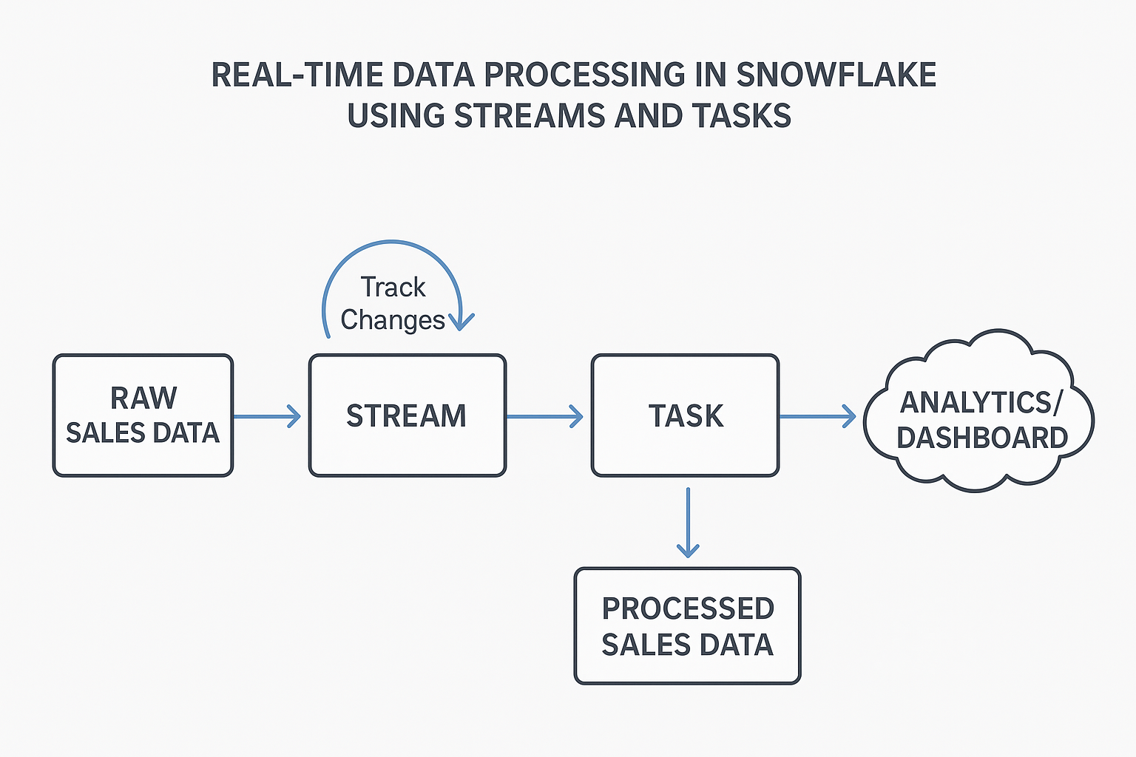

Slide 2
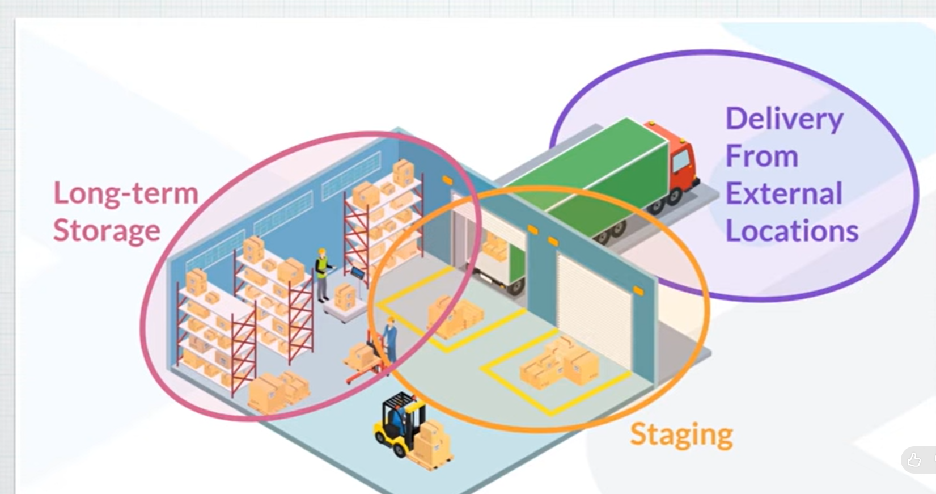
Implementing Real-Time Data Processing in Snowflake Using Streams and Tasks

Slide 3
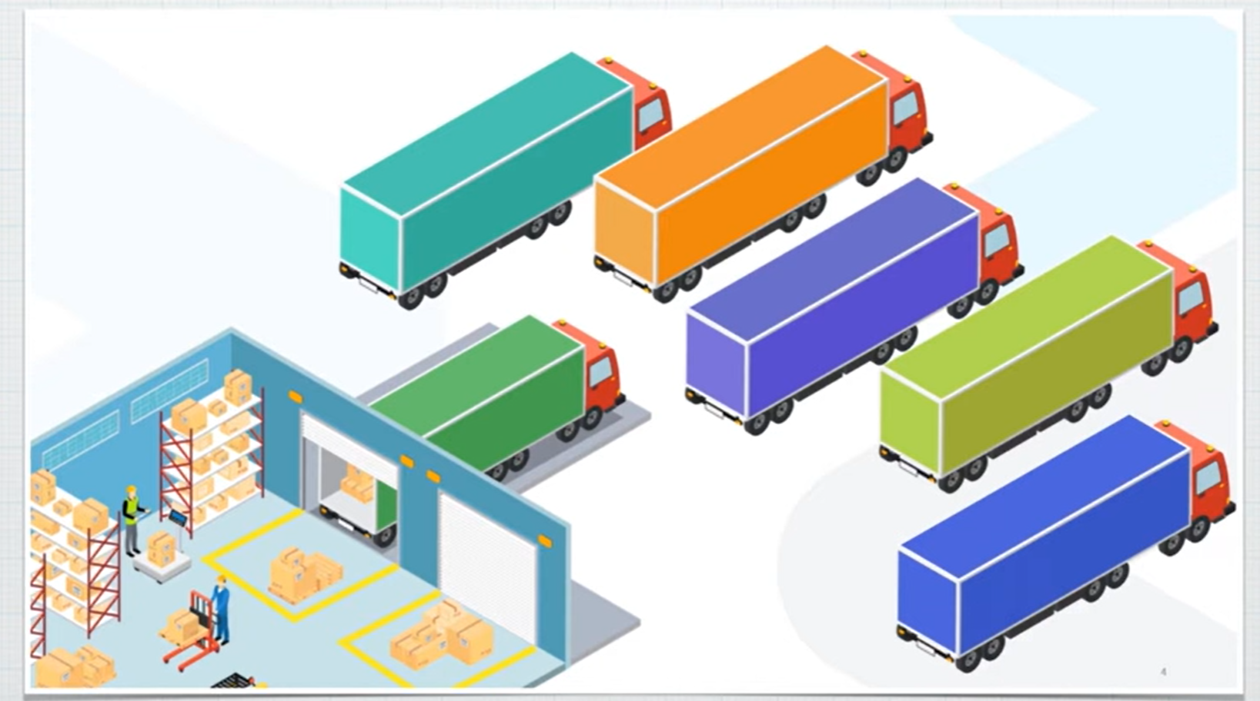

Slide 4
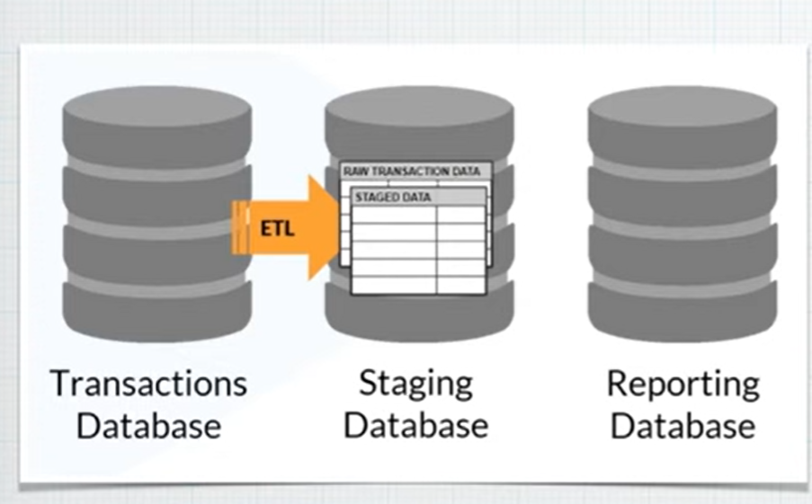

Slide 5
A Stream in Snowflake is an object that tracks data changes (DML) — specifically, INSERTS, UPDATES, and DELETES — on a table since the last time the stream was consumed.

Slide 6
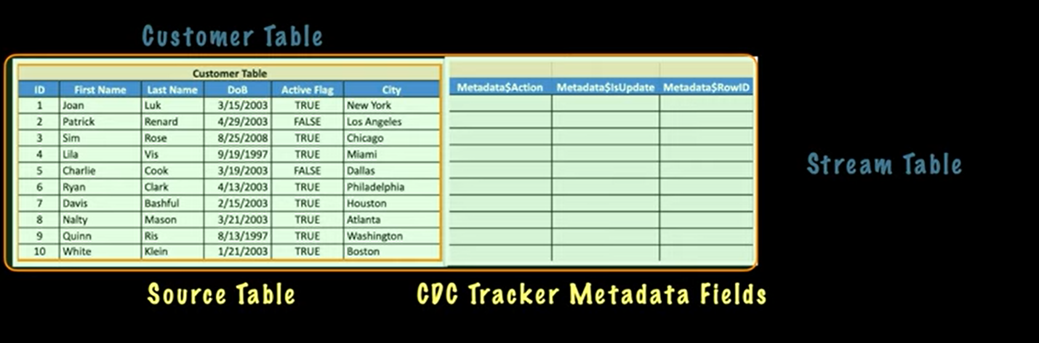

Slide 7
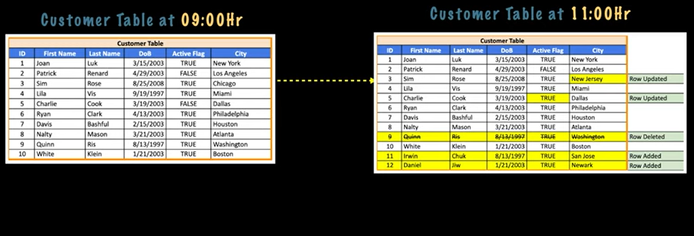
A dynamic table that continuously captures changes (inserts, updates, deletes) from a source table or data stream.

Slide 8
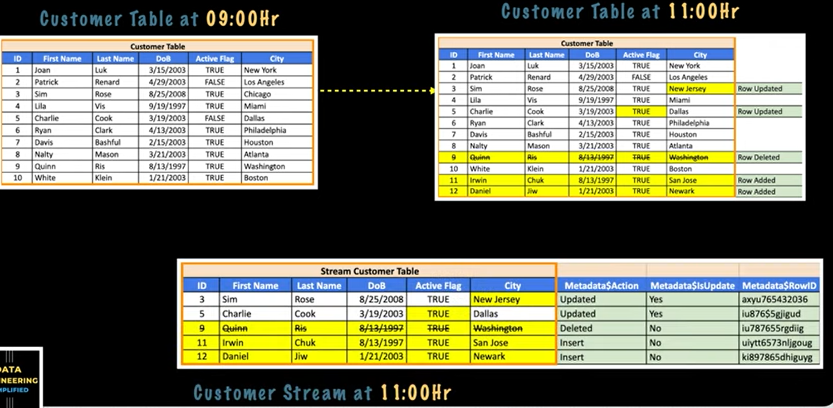

Slide 9
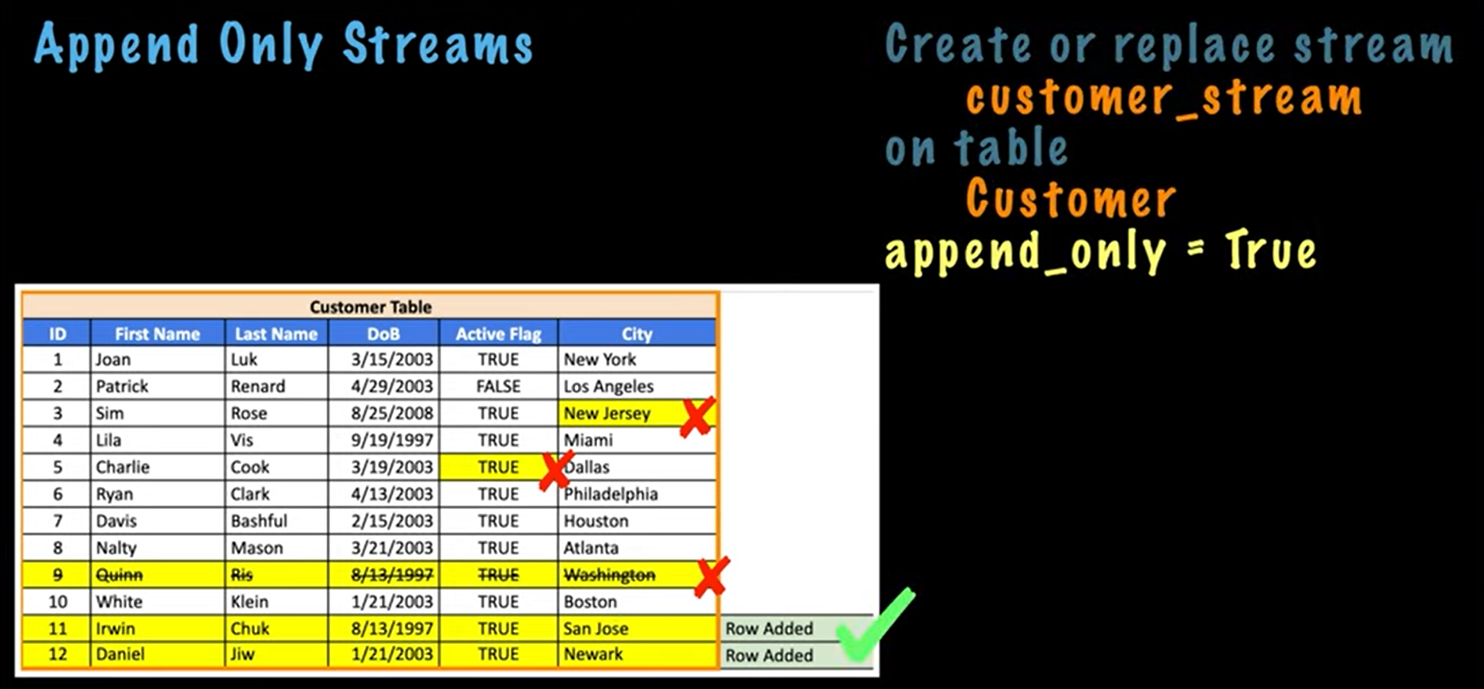

Slide 10
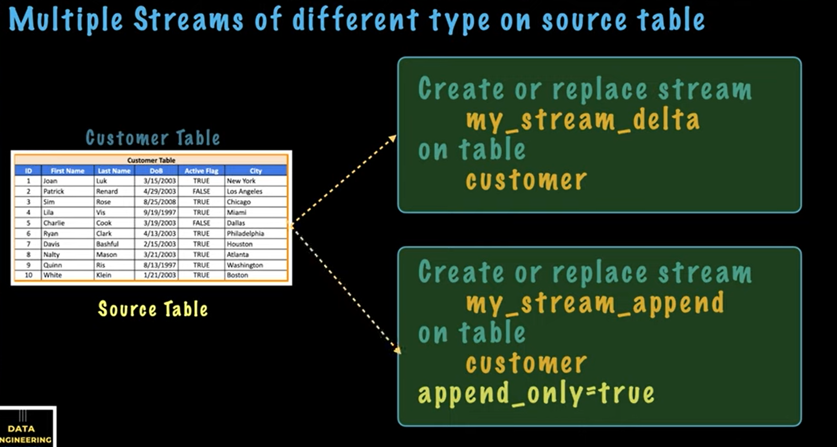

Slide 11
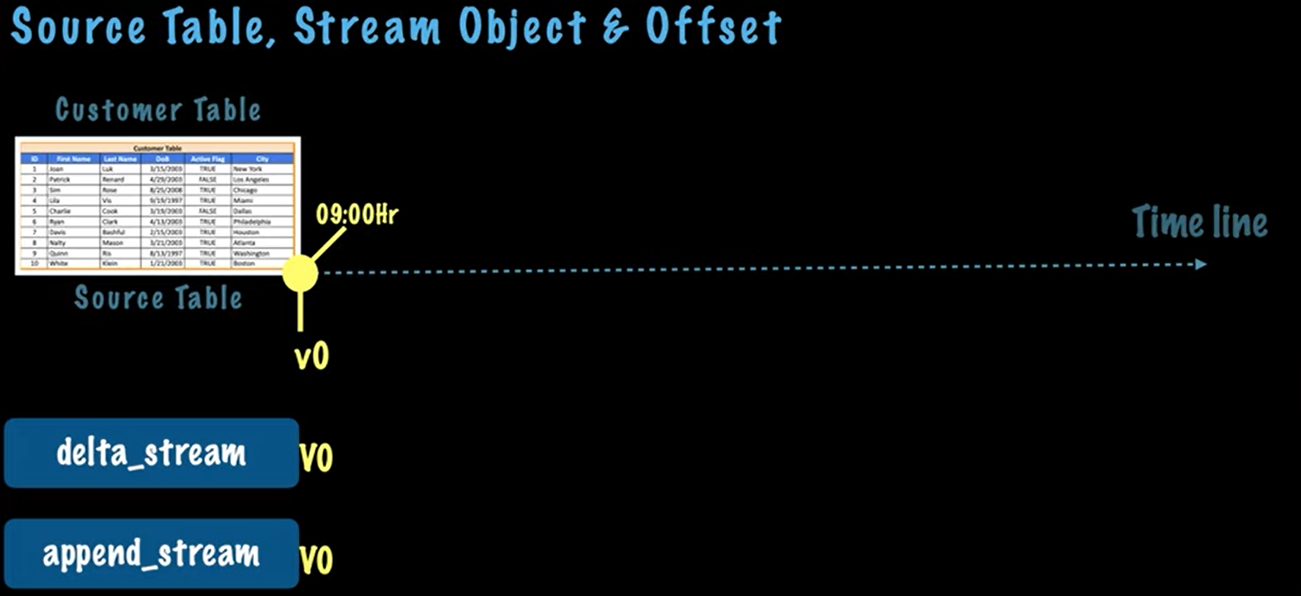

Slide 12
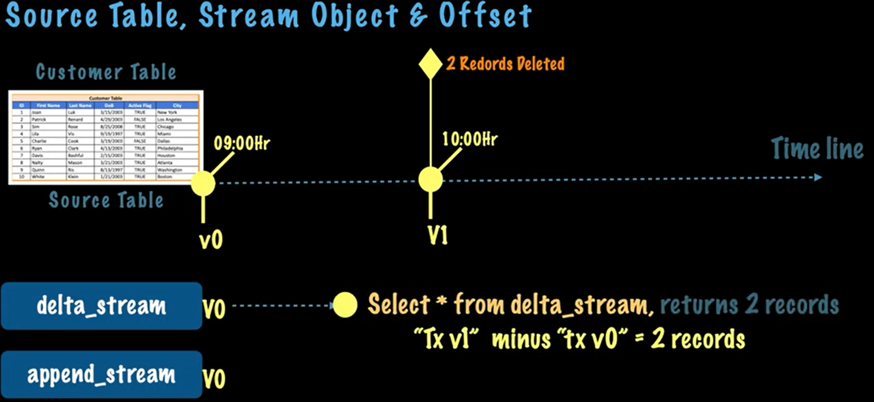

Slide 13
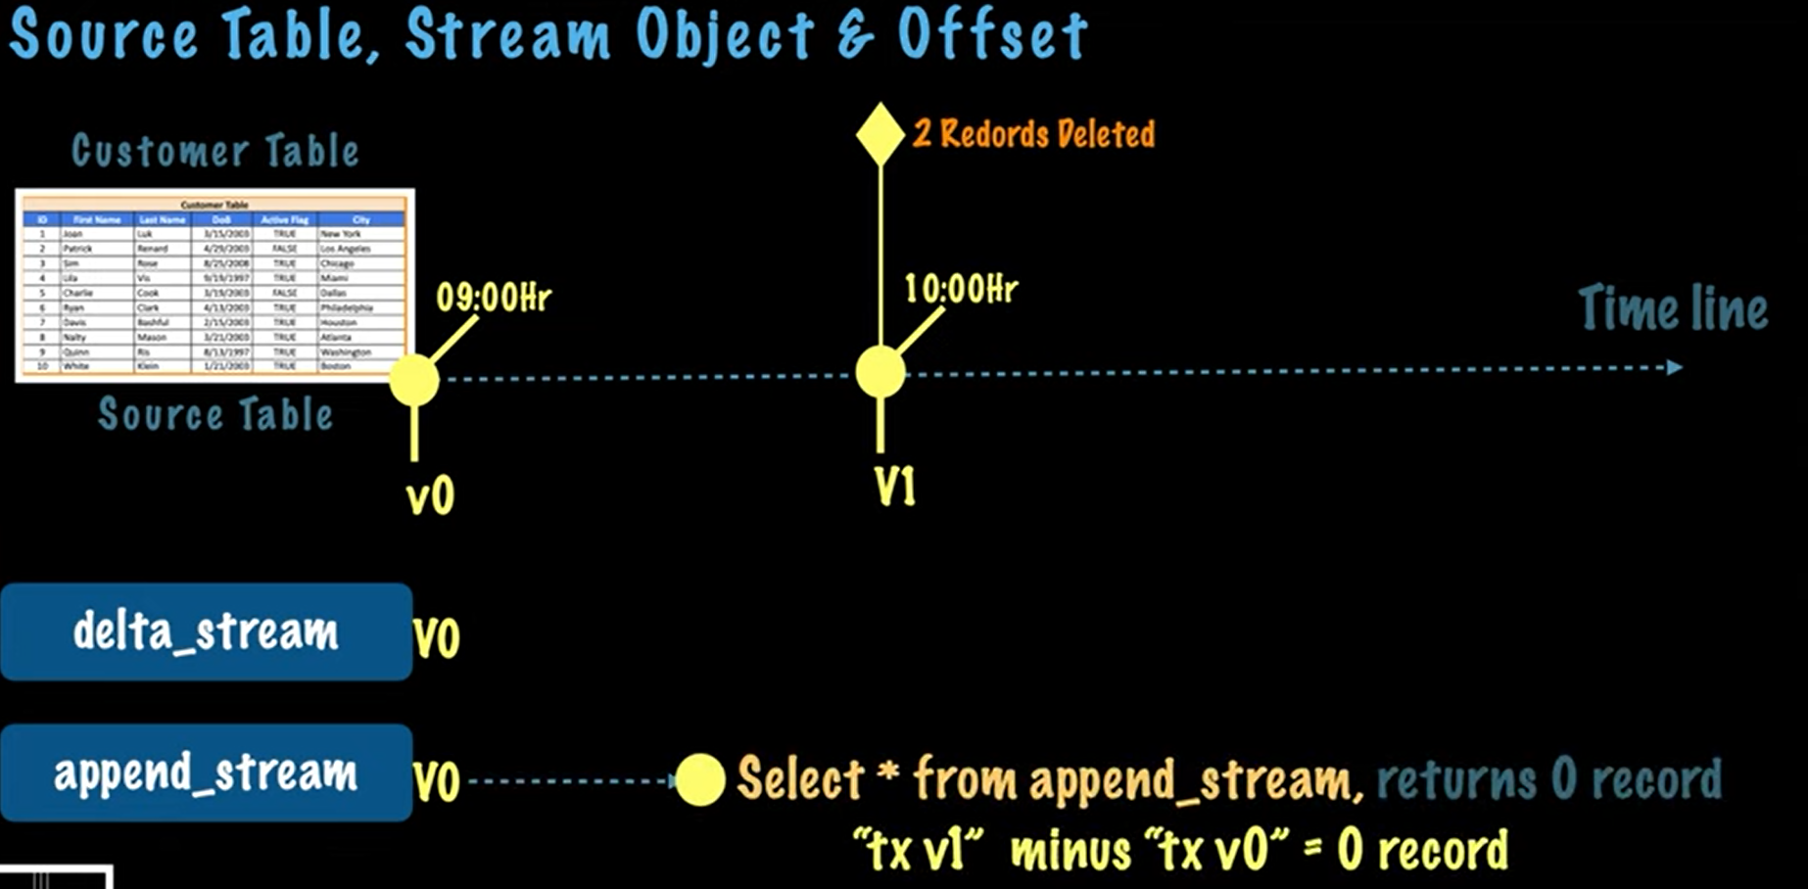

Slide 14
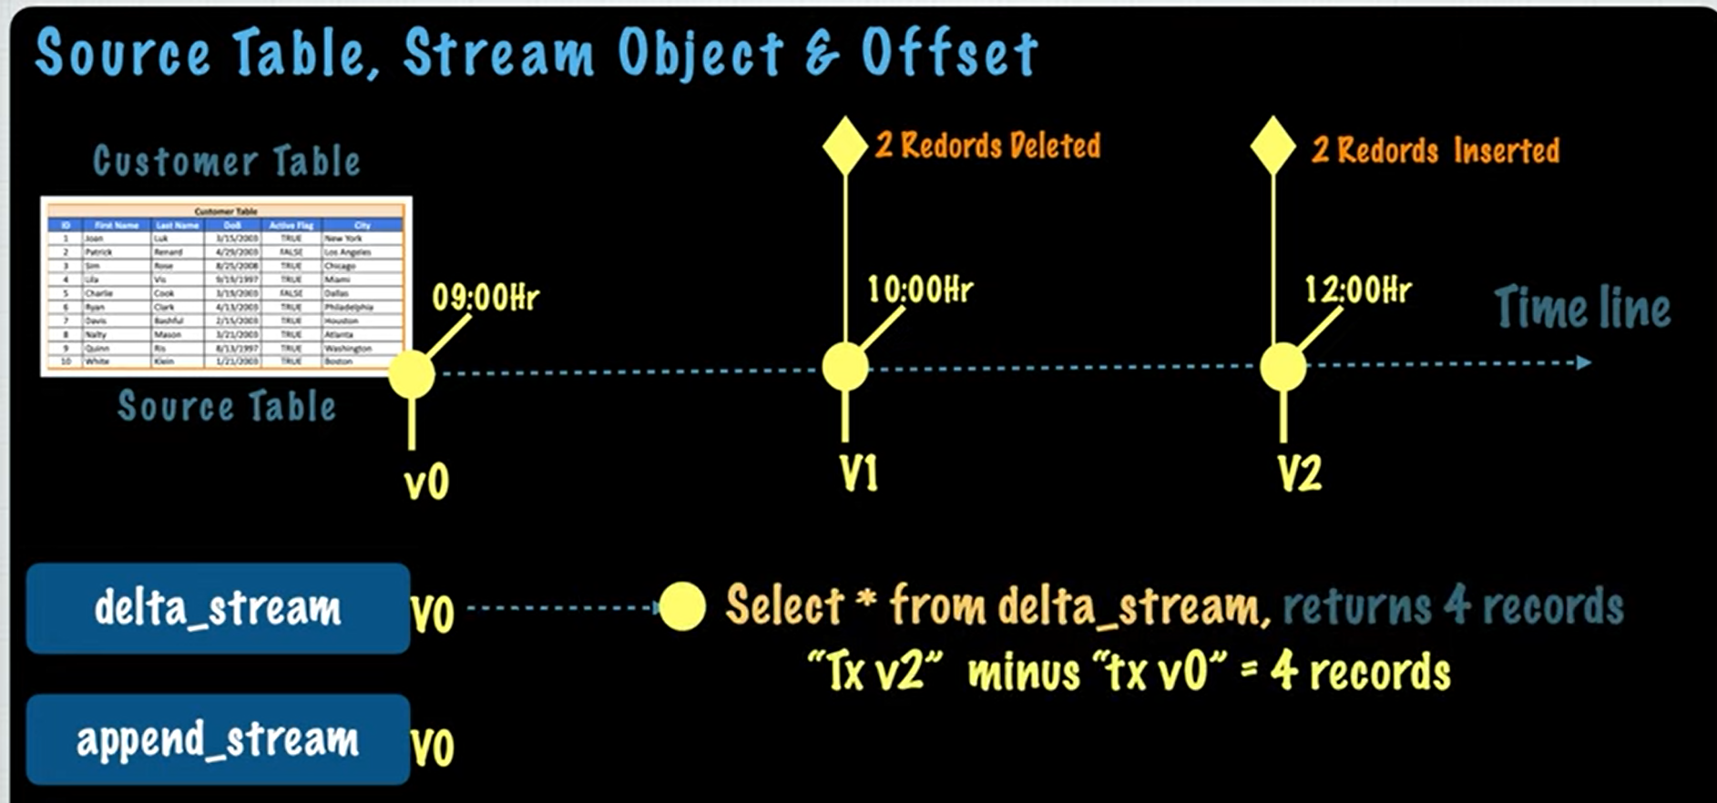

Slide 15
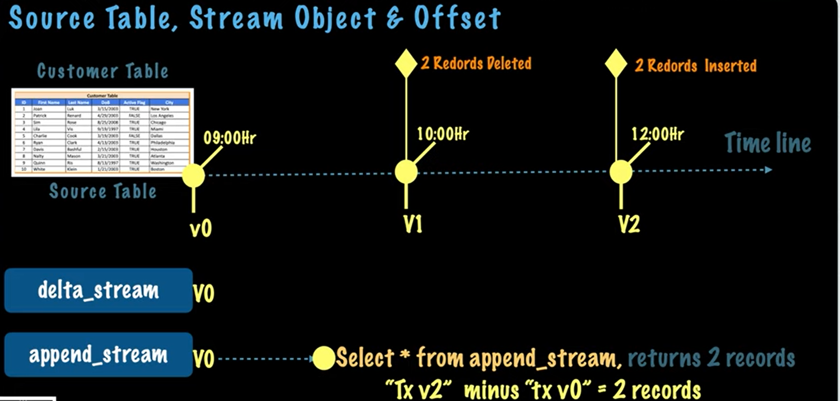

Slide 16
USE DATABASE STUDENT_DB;
USE SCHEMA LAB_SCHEMA;

